Slide 1
Speedrunning Database
Bryson TenHaken, Nicholas Cotcher, Charles Hubbard

Slide 2
What does it do?
Used for players to keep track of their latest records in their favorite games
Host multiple types of speedruns for multiple games
Allows users to submit and record their records and achievements for others to view

Slide 3
Key Design Aspects (ERD Next Slide)
User: User ID, Name, Email, Password, Admin, and Region ID
Region: Region ID, Region Name, Region Language
Platform: Platform Name, Platform ID, Release Date
Game: Game ID, Name, Release Date, Logo URL
System: System ID, Platform ID, Emulated: yes/no, Region ID
Game Platform: Game ID, Platform ID
Run: Run ID, Game ID, Title ID, Category ID, System ID, User ID
Tiime: Time ID, Real Milliseconds, In Game Milliseconds, Real Milliseconds No Load
Category: Category ID, Category Name, Category Rules

Slide 4
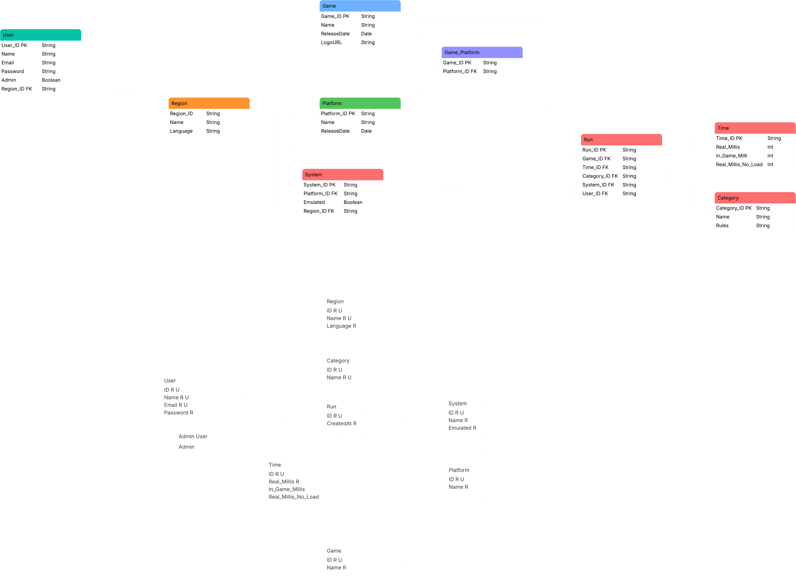

Slide 5
Implementation Highlights
‘Sup, Dude?

Slide 6
Problems/Challenges
Dunno

Slide 7
In Conclusion…
Let’s people connect and share achievements and records with each other
Built for multiple kinds of speedruns, allowing a congregation of genres
Place for the community

